Slide 1
Database development 17/81 Project
Group Members:
Jo-Anne van der Wath (577394)
Henry Roux (577440)
Rueben Slingerland (577666)
Success Mluleki Mdhluli (577712)
Lecturer: Mr Desire Sundire

Slide 2
Table of contents
Introduction
Section 1
ERD
Section 2
Tables
Queries
Forms
Reports
Macros
Conclusion
Image sources
Bibliography

Slide 3
Introduction
We were tasked with making a database management system for Milly’s Chocolate Factory based on the specifications given to us.
We will now be going through some of our work on the database we created and its ERD (Entity Relationship Diagram).

Slide 4
Section 1
Database Design

Slide 5
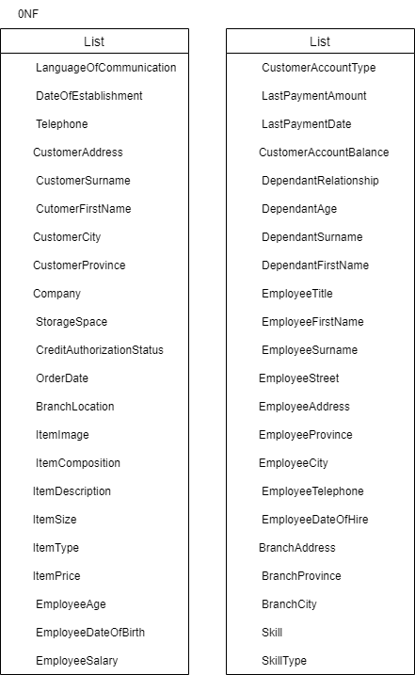
ERD ERDs are used to design the database, allowing users to create entities, add attributes and edit relationships between the entities in a logical way.
0NF: All attributes are listed in a single list.

Slide 6
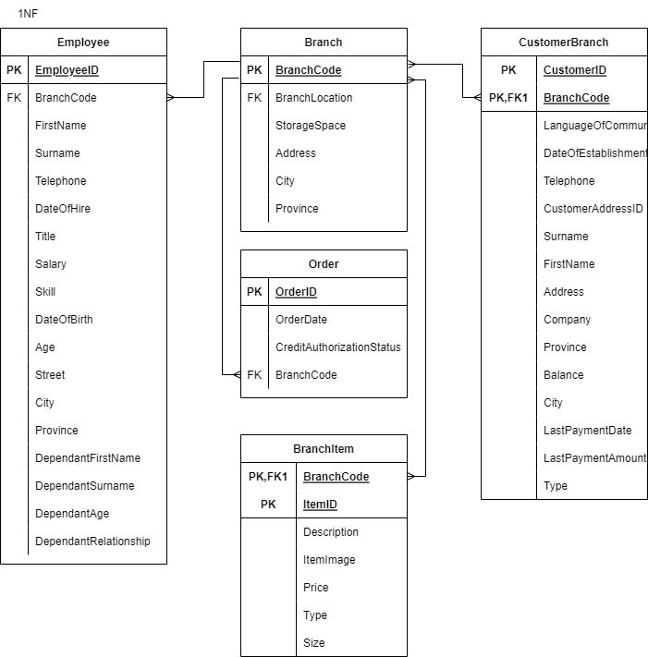
1NF: Groups of repeating attributes are removed.

Slide 7
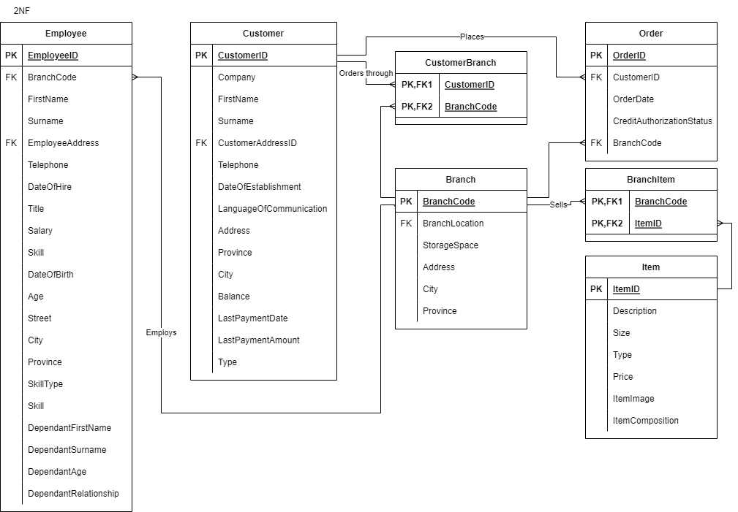
2NF: Partial dependencies are removed

Slide 8
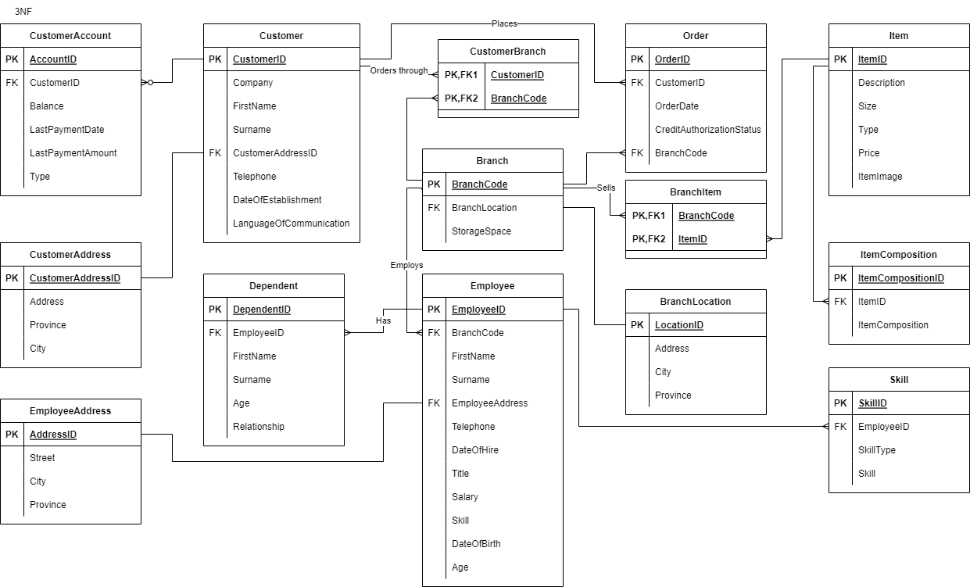
3NF: Transitive dependencies are removed

Slide 9
Section 2
Section 2: Microsoft Access

Slide 10
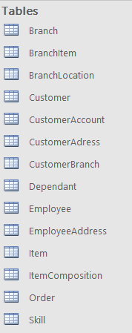
Tables
We created tables based on the entities from our ERD.
Each table contains the attributes from the corresponding entities in the ERD.

Slide 11
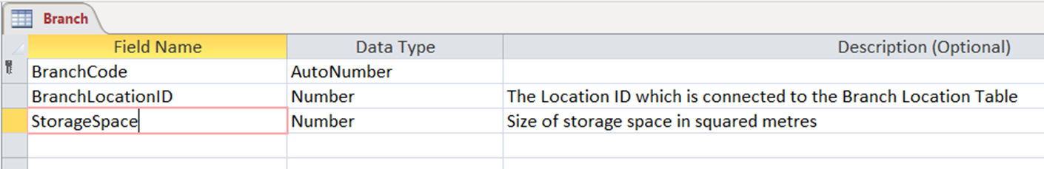
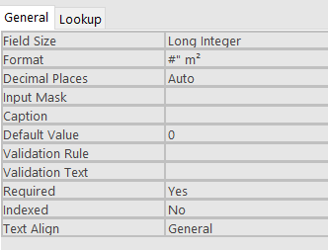
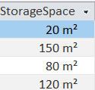
Formatting
When creating tables, we made use of formatting to store and display values in a particular way.

Slide 12
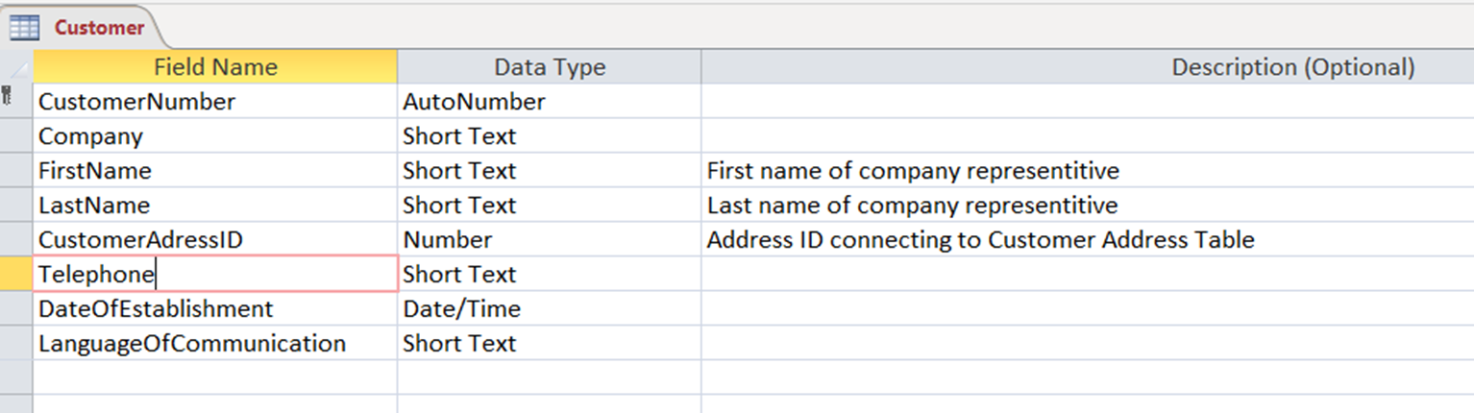
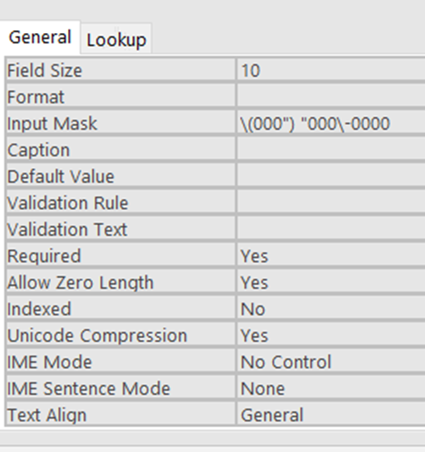

Input mask
Input masks were used to ensure that data was entered in a consistent format.

Slide 13
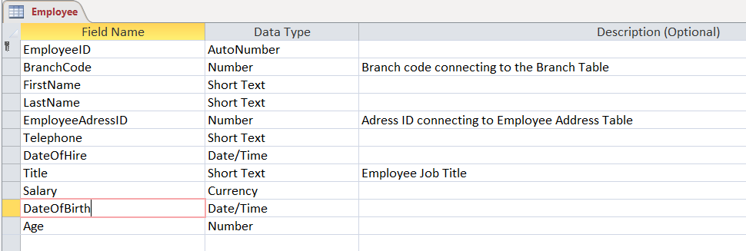
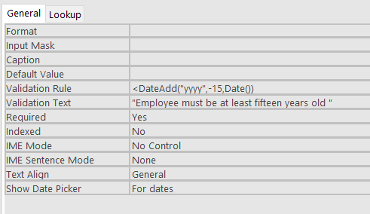
Validation rules
Validation rules were used to restrict and ensure valid input from the user.
The validation text is used to inform the user of the rule they are breaking.

Slide 14
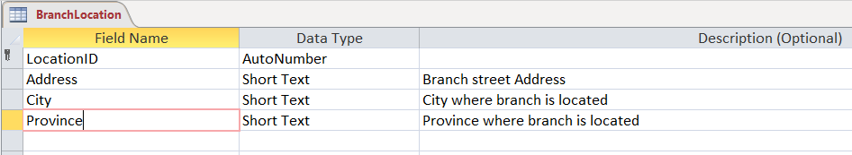
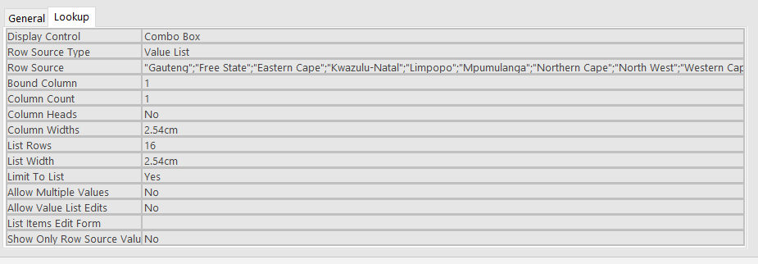
Lookup fields
Lookup fields were used to allow users to choose input from given options.
This was used to limit user input errors.

Slide 15
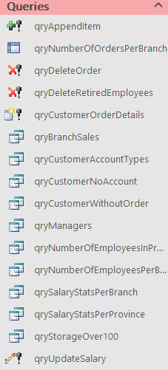
Queries
Queries were used to manipulate the tables to produce information that can be used by the user.
We used queries to append, delete and update records as well as to create new tables and perform calculations. Crosstab queries were also used to show summarised data.

Slide 16
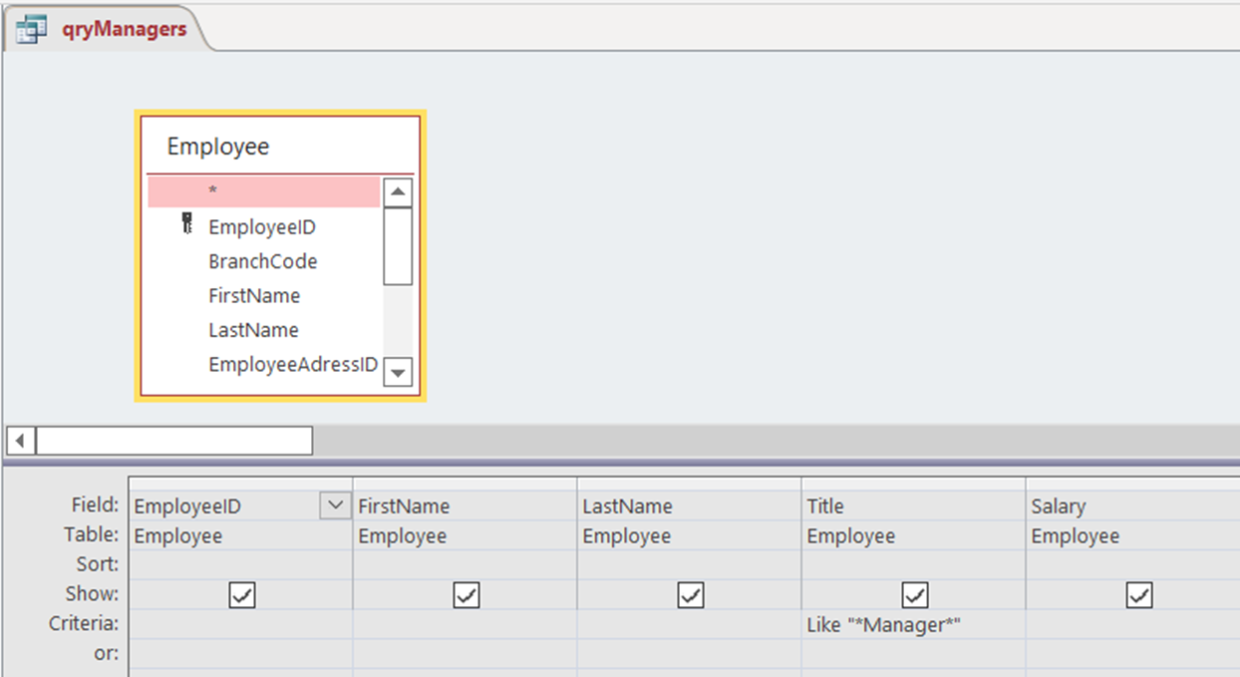
Basic Query
In numerous queries we made use of criteria to show only applicable records.

Slide 17
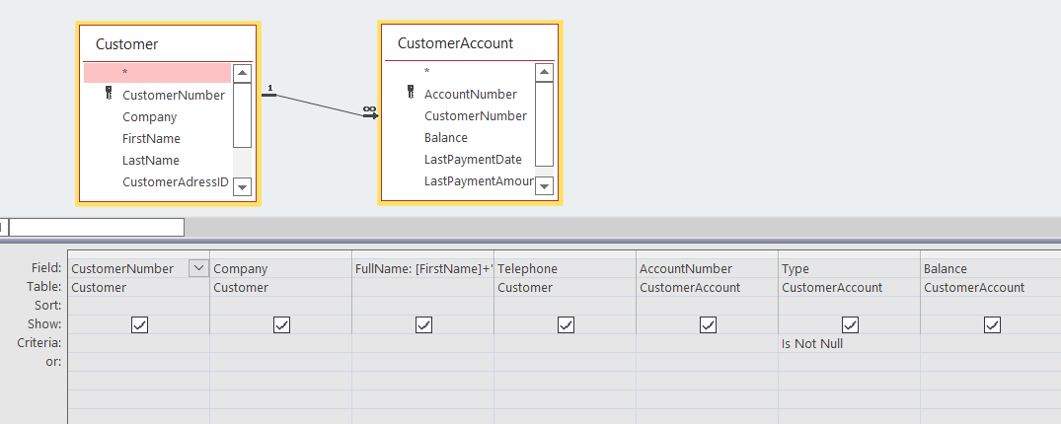
Joined query
Inner joins and left joins were used in multiple queries to display related records from different tables in a single query.

Slide 18
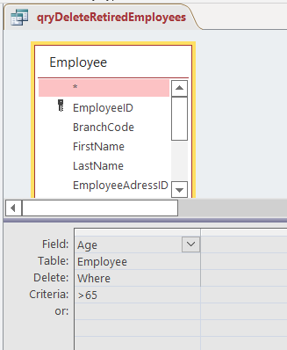
Delete Query
We used the Delete query to delete records that satisfy the criteria.

Slide 19
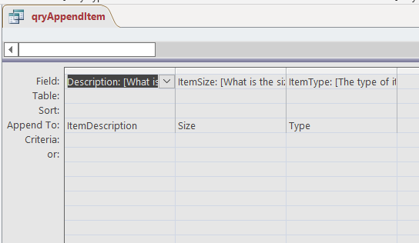
Append Query
The append queries were used to add records to specified fields.

Slide 20
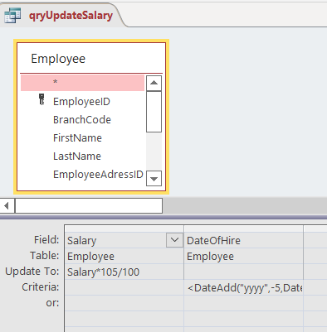
Update Query
An update query was used to update records that satisfied the set criteria.

Slide 21
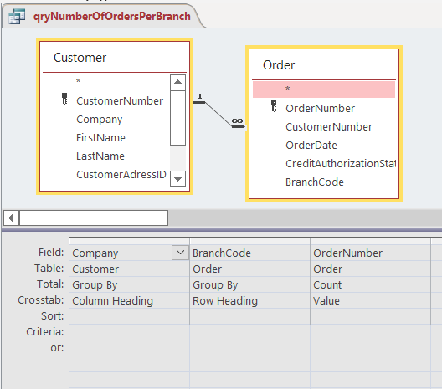
Crosstab Query
A crosstab query was created to display calculated records in a tabular format.

Slide 22
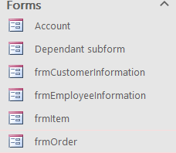
Forms
We created the following forms to allow for user input:
frmCustomerInformation
frmEmployeeInformation
frmItem
frmOrder.
Account is a subform in frmCustomerInformation and Dependent subform is a subform in frmEmployeeInformation.

Slide 23
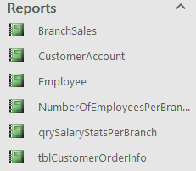
Reports
Reports were created to display the summarised data to users in a readable, easy-to-use way.
The user will make use of reports to make business decisions.

Slide 24


Macros
Macros were used to create a splash screen as well as a switchboard menu.
Forms were created for these macros.

Slide 25
Conclusion
Now that you know how our database works we will be taking a better look at it in practise and show you how to use it.

Slide 26
Image Sources:
Audrey. (2022). Mint Chocolates. Retrieved from unconventional baker: https://www.unconventionalbaker.com/recipes/vegan-mint-chocolates/
Canbridge Dictionary. (2022). toffee. Retrieved from Cambridge Dictionary: https://dictionary.cambridge.org/us/dictionary/english/toffee
Chocolatecoveredkatie. (2017). No Bake Coconut Bounty Bars. Retrieved from Chocolatecoveredkatie: https://chocolatecoveredkatie.com/homemade-coconut-bounty-bars-vegan/
HASMART. (2022). BOX (36) SIPPY SHERBET WITH STRAW GREEN. Retrieved from HASMART: https://hasmart.co.za/product/shop-by-department/edibles/chocolates-and-sweets-edibles/box-36-sippy-sherbet-with-straw-green/?v=fb1c5b0d2f97
Kuo, E. (2021, July 30). XYLITOL CHEWING GUM: IS IT SAFE? Retrieved from New Leaf: https://www.newleafrp.com/blog/xylitol-chewing-gum-is-it-safe/
Walmart. (2020). SweetGourmet Strawberry Filled Candies | Arcor Premium Bulk Wrapped Hard Candy | 2 Pounds. Retrieved from Walmart: https://www.walmart.com/ip/SweetGourmet-Strawberry-Filled-Candies-Arcor-Premium-Bulk-Wrapped-Hard-Candy-2-Pounds/168270027
Samira. (2020, June 19). How to make milk chocolate. Retrieved from Alphafoodie: https://www.alphafoodie.com/how-to-make-homemade-milk-chocolate/
Sevier, J. (2019, August 2). The Best Marshmallows You Can Buy at the Store. Retrieved from Epicurious: https://www.epicurious.com/ingredients/taste-test-the-best-marshmallow-you-can-buy-at-the-store-article

Slide 27
Bibliography
Gerencer, T. (2022, May 5). 450 Job Titles for Professional Positions [List of Examples]. Retrieved from zety: https://zety.com/blog/job-titles
jobs.ie. (2022). Personal skills. Retrieved from jobs.ie: https://www.jobs.ie/job-talk/personal-skills/#:~:text=Personal%20skills%20are%20recognised%20as,%2Dsolving%2C%20and%20analytical%20skills.
Moqbel, M. (2017, April 13). Adding Image or Picture to MS Access Table and Form. Retrieved from YouTube: https://www.youtube.com/watch?v=dXhu6xXWTbM
novoresume. (2022, March 16). Job Titles - Examples for Your Resume & Job Search for 2022. Retrieved from novoresume: https://novoresume.com/career-blog/job-titles-on-resume
Random Addresses in South Africa. (n.d.). Retrieved from BestRandoms: https://www.bestrandoms.com/random-address-in-za?quantity=20
Random Name Generator - First & Last Names. (n.d.). Retrieved from FossBytes: https://fossbytes.com/tools/random-name-generator
South Afican Government. (n.d.). South Africa's provinces. Retrieved from South Afican Government: https://www.gov.za/about-sa/south-africas-provinces
Streiff, C. (2022, May 18). Professional Skills for a Resume (List of Examples). Retrieved from zety: https://zety.com/blog/professional-skills#:~:text=Professional%20skills%20are%20a%20combination,and%20more%20difficult%20to%20learn.

